Slide 1
Cloud Gaming:
Architecture and Performance
Ryan Shea and Jiangchuan Liu, Simon Fraser University
Edith C.-H. Ngai, Uppsala University
Yong Cui, Tsinghua University

Slide 2
Outline
Introduction
Example
Issues and Challenges
Real World Performance: Onlive
Conclusion and Further Discussion

Slide 3
Introduction
Cloud computing
Computational offloading
Reducing user access latencies with cloud data centers
Notes:
不只是簡單的運算，甚至3D rendering→cloud gaming

Slide 4
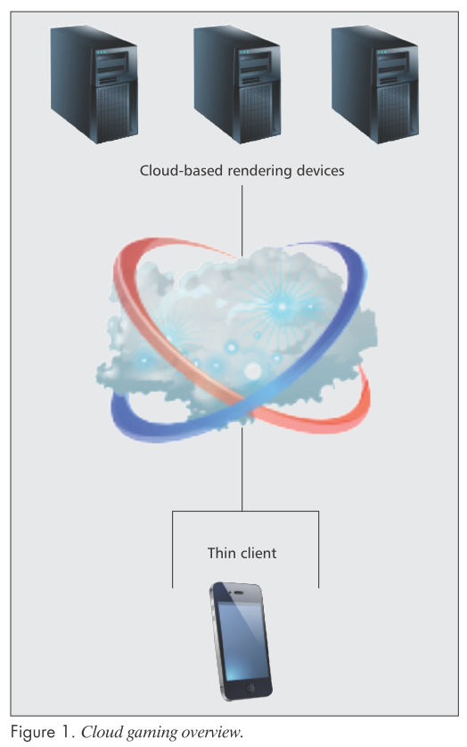
Introduction
Cloud gaming Architecture
Notes:
Thin client action→Cloud

Slide 5

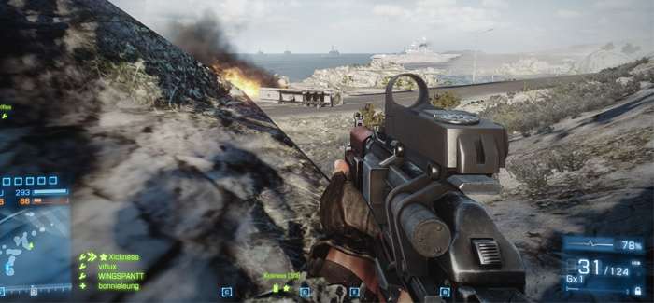
Example
Gaikai - Battlefield 3
Requirement
quad-core CPU
4 Gbytes RAM
20 Gbytes storage space
graphics card (at least 1 Gbyte RAM)
Tablets (iPad Retina, Nexus 10)
dual-core CPU
2 Gbytes RAM
graphics card (512 Mbytes RAM)
Notes:
電腦需要高規格，但是手機和平板沒辦法，軟硬體架構也不同

Slide 6
Example
Advantage
reduces customer support costs
better digital rights management (DRM)

Slide 7
Issues and Challenges
Cloud Gaming System
collect a player’s actions
transmit actions to the cloud server
process the action
render the results
encode/compress the resulting changes to the game world
stream the video(game scenes) back to the player
Interaction Delay
Notes:
確保interactivity，以上的流程要在數毫秒之間完成

Slide 8
Issues and Challenges
Trade-offs
Player’s delay tolerence↓
System process time↓
Network latency negatively affecting player

Slide 9
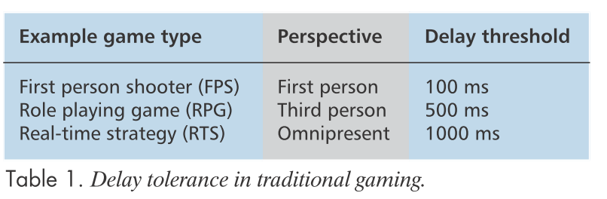
Issues and Challenges
Interaction Delay Tolerance
Notes:
FPS - action-based，CS
RPG - 如施放魔法前會唸咒語，不需要太及時，魔獸世界
RTS - “omnipresent” view，看全景，星海爭霸

Slide 10
Issues and Challenges
Consideration of Interaction Delay
Conjecture of Interaction Delay:
Cloud gaming - 200ms
Action-based game - 100ms
 | Single-Player Game | Multi-Player Game
Tradition (No Cloud) | No | Yes
Now (Cloud) | Yes | Yes
Notes:
傳統Multi-Player作法：先在local將動作跑完，不用等待資料從server回傳，可以隱藏interaction delay。
現在cloud game offloading: local太差沒辦法先跑完動作

Slide 11
Issues and Challenges
Video Streaming and Encoding
Video Encoder: H.264/MPEG-4 AVC encoder
Gaikai - software-based approach
Onlive - specialized hardware
 | Live media streaming | Cloud gaming
Same | Quickly encode/compress incoming video and distribute it to end users
Client Buffer | Yes | No
Notes:
沒buffer: 送command到cloud→game logic處理→render→用video encoder壓縮成影片→送回user
H264: high compression ratio

Slide 12
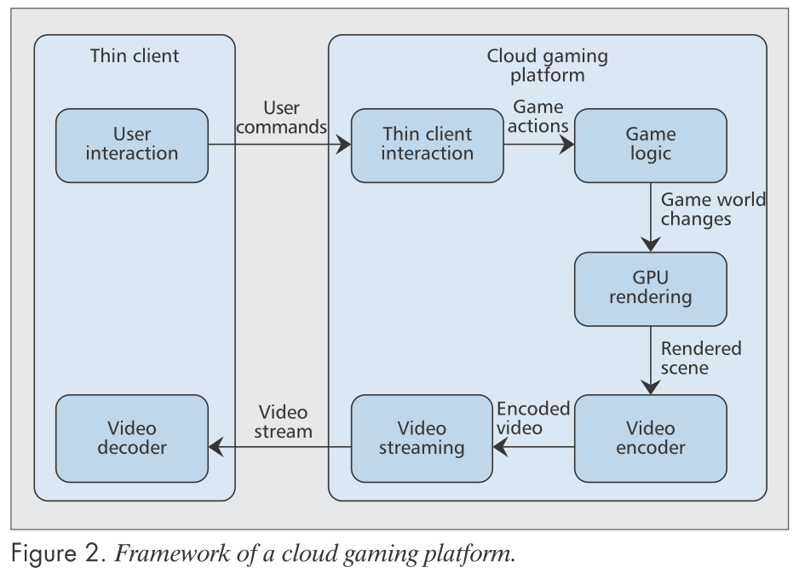
Issues and Challenges
Cloud Gaming Framework

Slide 13
Issues and Challenges
Traffic measurement and analysis - United States, Canada, China, and Japan
Gaikai - Two public clouds (Amazon EC2 and Lime-light)
Onlive - One private clouds
Server
Deliver Gaikai game client
EC2 VM
Player
Proxy
Forward game proxies IP
Choose a proxy
Send actions
Receive reactions
Notes:
利用wireshark解4個networks底下的封包了解thin clients和cloud之間的互動
public cloud: low cost, high scalability
private cloud: high performance, customizable

Slide 14


Real World Performance: Onlive
Analysis two metrics
Interaction delay (response time)
Image quality
Same hardware
AMD 7750 dual core processor
4 Gbytes of RAM
1-Tbyte 7200 RPM hard drive
AMD Radeon 3850 GPU
Wired connection (25Mb/s / 3Mb/s)
Notes:
北美最早的cloud gaming公司之一，250萬註冊、150萬活躍用戶
Batman Arkham Asylum 蝙蝠俠：阿卡漢瘋人院

Slide 15
Real World Performance: Onlive
Measuring Interaction Delay
MSI afterburner - Control GPU
Screen capture software 100fps - 10-ms granularity
1/4 resolution
Motion JPEG compression
Less than 5% of the CPU and 1Mbyte/s writing to the disk

Slide 16
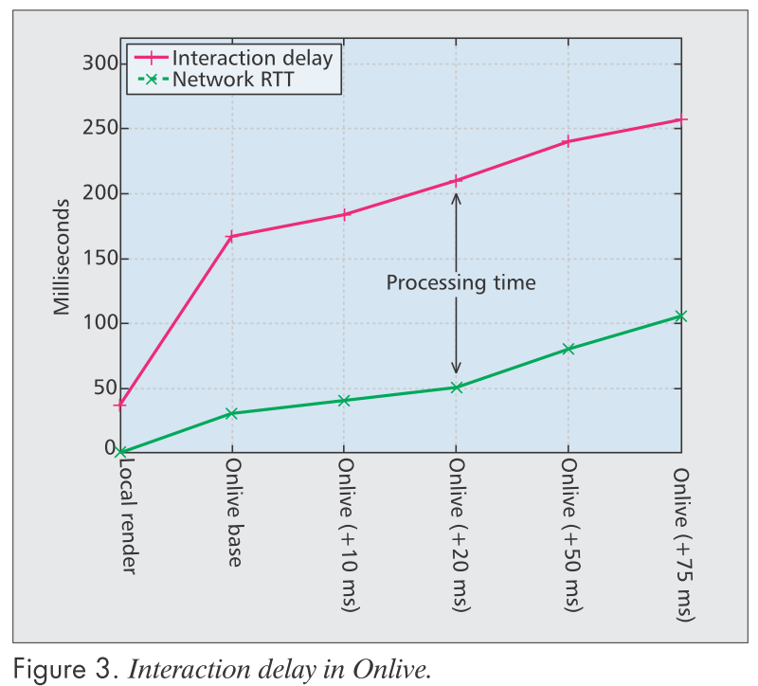
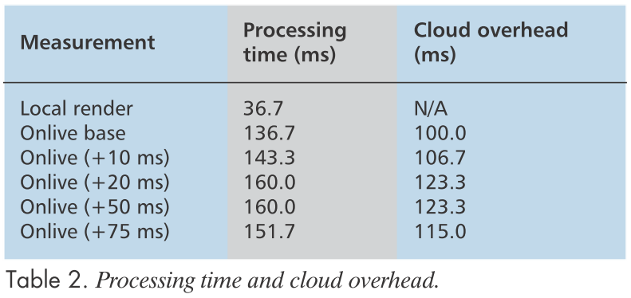
Real World Performance: Onlive
Linux network emulator Netem
Average 30ms RTT with 2ms std to Olive
Three samples for each experiment (average to one result)
Notes:
在test system和internet之間放一台linux機器，用來製造latency
cloud overhead - delay caused by the video encoder and streaming system
overhead超過100ms表示FPS無法玩，需要更好的encoder、streaming system

Slide 17
Real World Performance: Onlive
Measuring Image Quality
Proprietary Real Time Transport Protocol (RTP) - Packets hardly be captured and analyzed
Bandwidth control - 10Mb/s → 3Mb/s
Same 40-second (1200-frame) section from each video
Notes:
分析開場影片，1280x720(720p)，30fps，因此利用MSI afterburner去錄製相同的格式
用中間那台linux機器限制頻寬

Slide 18
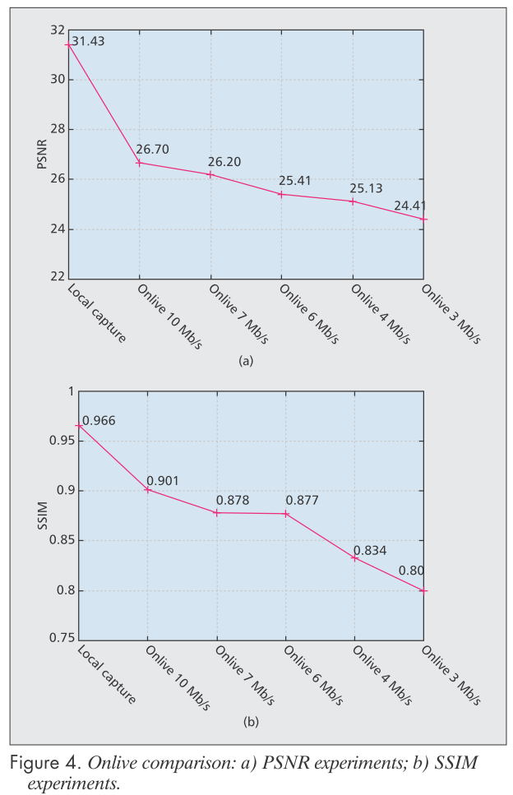
Real World Performance: Onlive
Peak signal-to-moise ratio (PSNR)=>單位dB
算每個pixel的差距做平均(MSE)
Structural similarity index method (SSIM)
比較兩個影片之間的相似程度(對比度、亮度、結構)
1代表一樣，-1代表完全不一樣
因為是用螢幕錄製程式所以再local端會不一樣
Notes:
PSNR: 峰值信號雜訊比，越高代表失真越少，單位dB，30以上人眼可接受，25以上mobile video streaming可接受
SSIM: 比較兩個影片的相似度
Local PSNR有細微的亮度顏色差異

Slide 19
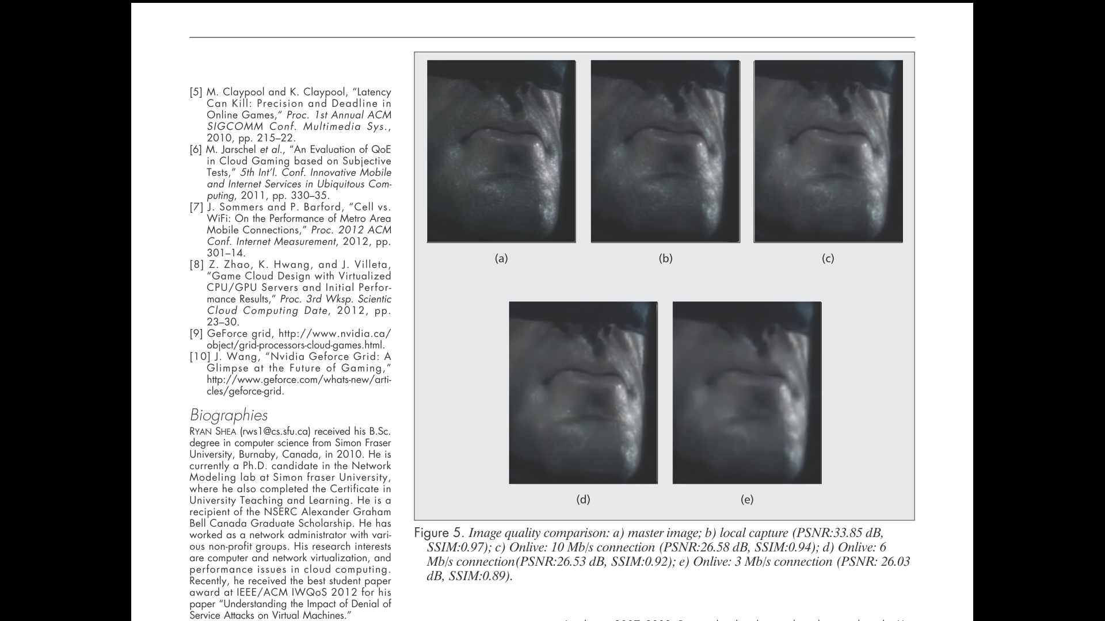
Real World Performance: Onlive

Slide 20



Conclusion and Further Discussion
Notes:
很難找到網路是在200ms內的latency，LTE是一個可能解決辦法
thin client可以幫忙做一些rendering、用方法hide interaction delay
用多台VM來玩(distributed game execution)
NVIDIA可以同時render 4個player的畫面，而且是在可接受的latency

